Slide 1
TED-Ed EARTH SCIENSE
我們如何判讀星辰

Slide 2
我們如何判讀星辰
01

Slide 3
天體與宇宙
Take a closer look at the night sky, stick out your thumb, and if you look at it with the Hubble telescope, under your thumb, there are more than a thousand galaxies. The study of astronomy is older in human history than navigation, agriculture, and perhaps the existence of language. Whenever you look up at the stars at night, you are actually participating in the oldest scientific activity in human history.

Slide 4
天體與宇宙
仔細看看夜空，伸出你的大拇指，如果用哈伯天文望遠鏡觀看，在大拇指底下，
就有超過一千個星系。天文研究在人類史上，比航海、農業、可能比語言的存在還
要古老。每當你在夜晚仰望星空時，實際上是在參與人類史上最古老的科學活動。

Slide 5
01
When the rain is clear and you have the opportunity to see a beautiful rainbow, how do you see the rainbow?
解
The rainbow is actually the spectrum of light emitted by the sun, refracted and reflected by water droplets in the atmosphere.

Slide 6
01
當雨過天晴有機會可以見到美麗的彩虹，請問你看到彩虹是如何產生的呢？
解
彩虹其實是太陽所發出的光，被大氣層的水珠折射與反射後所散發出的光譜。

Slide 7
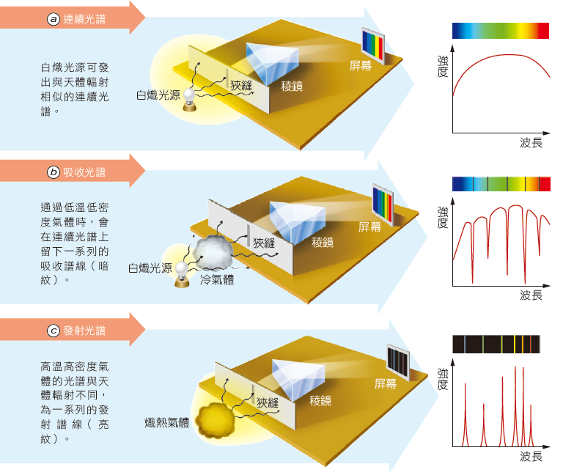
02
Referring to the attached figure, when we carefully observe the spectrum of sunlight, there is a strange phenomenon: there are some black lines in the spectrum, these black lines are like fingerprints, they are the unique ripples of atoms, is this a continuous spectrum, absorption spectrum or emission spectrum?
解
absorption spectrum

Slide 8
02
參考附圖，當我們仔
細觀察太陽光的光譜
時，有個奇怪的現象：
光譜裡有一些黑線，
這些黑線就像指紋一
樣，是原子的特有的
波紋，請問這屬於連
續光譜、吸收光譜還
是發射光譜？
解
吸收光譜。

Slide 9
03
Each atom absorbs only a certain wavelength of light, and the amount of light absorbed by these wavelengths depends on the number of atoms. So if we look at the spectrum of a star, what information can we get?
解
It is possible to speculate what elements the stars have, and even to calculate the proportion of elements.

Slide 10
03
每一種原子只會吸收某段特定波長的光，這些波長的光被吸收的量，取決於該原子數量的多寡。所以如果我們觀察某星體的光譜，就可以得到什麼資訊呢？
解
可以推測星體有哪些元素，甚至還可以推算出元素所佔的比例。

Slide 11
04
Our eyes see limited visible light, but we can still observe other bands, please try to use the example from the movie to complete the observation band on the left side of the table below?
解

Slide 12
04
我們眼睛所見的可見光有限，但仍可以用其他波段來進行觀測，請試著從影片中的舉例說明，完成下方表格左側觀測波段？
解

Slide 13
05
Studying different wavelengths can not only give us a more comprehensive understanding of an object, but also give us a different understanding of the universe. Therefore, astrophysicists use several different telescopes so that they can observe all kinds of light in their entirety, including far-infrared, ultraviolet and X-rays. Why?
解
It is best to set up in outer space, and outside the Van Allen radiation belt. Because the Earth's atmosphere absorbs far-infrared, ultraviolet and X-rays, it can only be observed outside the atmosphere, and the Van Allen radiation belt contains high-energy charged particles that can cause damage to electronic instruments.

Slide 14
05
承上題，研究不同的波長，不但可以讓我們對一個物體有更全面的了解，也可以讓我們對宇宙有不同的認識。因此，天文物理學家運用了幾種不同的望遠鏡，好讓他們可以完整觀察各種光線，包含遠紅外線、紫外線和Ｘ射線，請問這些望遠鏡最好架設在哪個地方？為什麼呢？
解
最好架設在外太空，並且在范艾倫輻射帶之外。因為地球大氣層會吸收遠紅外、紫外線和Ｘ射線，所以在大氣層之外才能進行觀測，而范艾倫輻射帶內有高能帶電粒子，對於電子儀器可能產生損害。

