Slide 1
化學
01
Fri.7 June 2024
What happens when you take
too much caffeine
Photo | depositphotos
Notes:
原文網址：https://www.bbc.com/future/article/20240605-what-happens-if-you-take-too-much-caffeine-and-how-much-is-too-much

Slide 2
化學
01

Slide 3
What happens when you take too much caffeine
Caffeine is an active ingredient in some of the world‘s favourite drink s and has a powerful effect on humans.
But recently, a brand of lemonade on sale in the US was discontinued amid accusations its caffeine content was dangerously high, despite reportedly being within the country‘s recommended daily intake of caffeine for adults. It has raised questions about just how much caffeine is too much, and does it matter where we get it from?

Slide 4
What happens when you take too much caffeine
How caffeine affects the body
There are many crucial functions at play in our bodies all the time, including heart rate, blood flow and sleep-wake cycles. Many of these affected by adenosine – a chemical that occurs naturally in your body, and whose job it is to make us tired at the end of the day.
Adenosine receptors are found on the outer surface of many cells in the body, and they react to variable levels of adenosine near the cell to send a command inside the cell to lower its level of activity. This promotes sleep in the heart, kidneys, immune system and other tissues.

Slide 5
What happens when you take too much caffeine
When we consume caffeine, it‘s quickly absorbed into our bloodstream, where it out-competes adenosine by preventing it from connecting to these receptors and doing its job. This is why consuming caffeine can make us feel more awake and alert. Caffeine can also boost levels of other neurotransmitters like dopamine and adrenaline, which can make you feel more stimulated.

Slide 6
What happens when you take too much caffeine
Health benefits of caffeine
An umbrella review analysing more than 200 meta-analyses in 2017 found that drinking three to four cups of coffee a day was more often linked to health benefits rather than harm, and that studies finding harmful associations could be explained by the higher proportion of coffee drinkers that also smoke.
In a review of evidence, scientists say that, while moderate coffee consumption can lower the risk of death, high blood pressure and heart failure, there was no clear effect found on coronary heart disease risk.

Slide 7
What happens when you take too much caffeine
Studies show that coffee can also have an effect on how well we exercise. One study of amateur cyclists found it can improve physical performance by up to 1.7%. Caffeine has also been associated with a decreased risk of several forms of cancer, heart disease and type 2 diabetes.
Coffee – but not tea – has consistently been found to protect against depression, and there‘s also evidence that adenosine’s antagonists, including caffeine, that block adenosine receptors, are beneficial for the ageing brain. In fact, research has associated caffeine consumption with up to a 60% reduced risk of developing Alzheimer's dementle.

Slide 8
What happens when you take too much caffeine
One explanation for this is that caffeine improves blood flow to the brain. The brain burns a huge amount of fuel, he says – despite only weighing around 2% of our body weight, it accounts for more than a quarter of our body's entire energy requirements.
Coffee has also been associated with healthy compositions of gut microbes, partly thanks to the bioactive polyphenol and alkaloid compounds – of which caffeine is one – it contains. It is well established that the right composition of gut microbiota can have widespread effects on our health.

Slide 9
What happens when you take too much caffeine
And it‘s worth noting, some of the health benefits associated with coffee are not down to its caffeine content. Chlorogenic acid, a compound unique to coffee, for example, may be behind some of coffee’s beneficial health outcomes, particularly diabetes. Population data strongly shows that coffee-drinking reduces diabetes, but the effects are also found with decaf, so it‘s probably not related to caffeine.

Slide 10
What happens when you take too much caffeine
How much is too much caffeine?
It‘s easy to overload on caffeine, and you’ll know when this happens, because you may start to feel nauseous, anxious and irritable, and develop a headache. You might also start to feel premature ventricular contractions – which are extra heartbeats, as the heart‘s pacemakers become irritable.
And if you consistently drink high amounts of caffeine over time, you‘re more likely to experience withdrawal symptoms if you suddenly stop consuming it, but research suggests they can occur with daily doses as low as 100 mg. The mechanism behind withdrawal symptoms is the same mechanism that causes caffeine's stimulant effects.

Slide 11
What happens when you take too much caffeine
Individual differences
There are at least eight genes we inherit that are associated with caffeine intake, including ones that influence neurological stimulation, the psychoactive effects of coffee on the brain, how quickly we metabolise coffee, how much we can tolerate, and how much we enjoy it. This
difference is largely because of the genetic variants in the CYP1A2 enzyme in our bodies, which represents more 90% of caffeine metabolism. This is where the health benefits associated with caffeine become more complicated.

Slide 12
English | Chinese | explain
caffeine | 咖啡因 | A chemical, found in coffee and tea, is a stimulant.
accusation | 指控 | A claim that someone has done something wrong or illegal.
intake | 攝取量 | The amount of a particular substance that is consumed or absorbed.
crucial | 重要的 | Extremely important or necessary.
adenosine | 腺苷 | A chemical in the brain that promotes sleep and relaxation.

Slide 13
English | Chinese | explain
kidney | 腎臟 | An organ in the body that take away waste matter from the blood to produce urine.
neurotransmitter | 神經傳導物質 | A chemical that carries messages between neurons and muscles.
dopamine | 多巴胺 | A neurotransmitter associated with pleasure.
adrenaline | 腎上腺素 | A hormone that increases heart rate and energy in response to fear, anger or excitement.
moderate | 適度的 | Neither small nor large in amount or degree.

Slide 14
English | Chinese | explain
amateur | 業餘的、 非專業的 | Doing something for pleasure or enjoyment, not as a job.
diabetes | 糖尿病 | A disease that body cannot control the level of sugar in the blood.
depression | 抑鬱症 | A mental illness that a person is very unhappy and anxious for a long time.
Alzheimer’s dementia | 阿茲海默症 | A disease of the brain that results in the loss of memory, movement and the ability to think clearly..
gut microbe | 腸道微生物 | Tiny life forms aid digestion in the digestive system.

Slide 15
English | Chinese | explain
chlorogenic acid | 綠原酸 | A natural compound found in coffee and certain plants, known for its antioxidant properties and potential health benefits.
premature ventricular contraction | 心室性早期收縮 | When the heart’s ventricles beat earlier than they should, causing an irregular heartbeats.
pacemaker | 心律調整器 | A device that regulates the heartbeat.
withdrawal sympton | 戒斷症狀 | The unpleasant physical and mental effects that result when you stop doing or taking something.

Slide 16
English | Chinese | explain
stimulant | 興奮劑 | A substance that increases activity in the body or brain.
metabolise | 代謝 | To use chemical processes in the body to turn food into energy.
enzyme | 酶；酵素 | A protein that speeds up chemical reactions in the body.

Slide 17
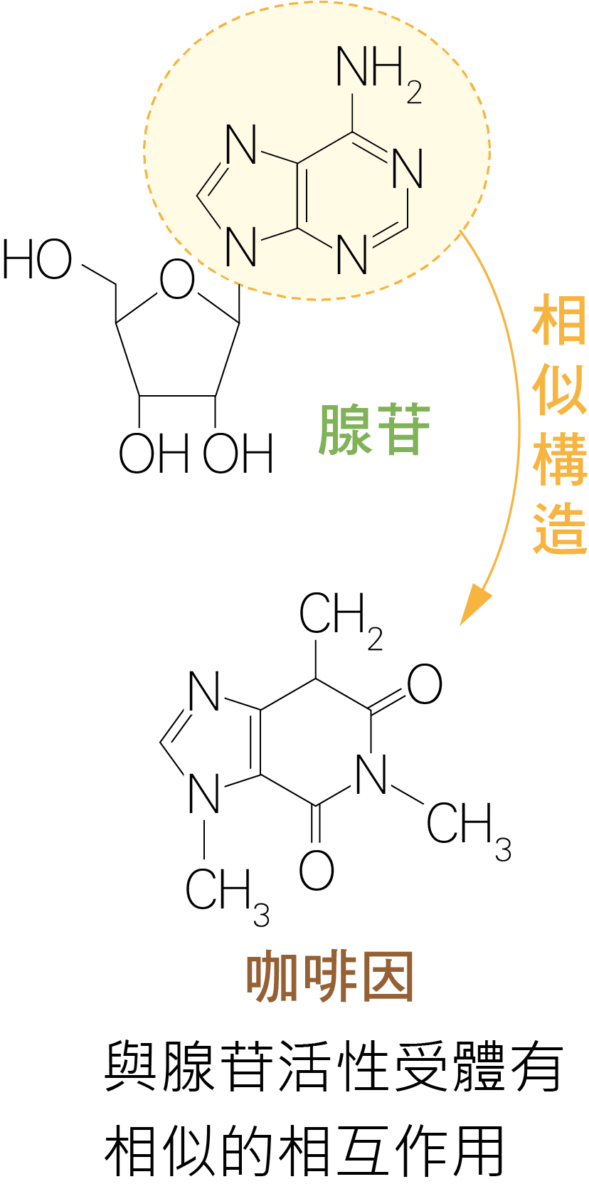
How Caffeine Works in the Body
Drinking coffee helps people stay alert, mainly because of the caffeine it contains. Caffeine is a natural alkaloid that produced by many plants as a self-defense mechanism. Insects can be paralyzed or even killed by consuming too much caffeine.
As the brain is active, the body gradually feeds tired. The brain releases a neurotransmitter called adenosine.

Slide 18
How Caffeine Works in the Body
When adenosine binds to adenosine receptors, it slows down the activity of central neurons, allowing the brain to enter a state of sleep. After rest, the amount of adenosine decreases, neurons become active again, and the individual wakes up.
The structure of caffeine is similar to that of adenosine, so it competes with adenosine for receptors. When caffeine binds to receptors, it reduces the amount of adenosine binding.
Caffeine acts like a “blocker” for adenosine receptors, preventing them from telling the brain it needs rest. However, adenosine accumulates gradually. Once caffeine is metabolized, the individual feels even sleepier.

Slide 19
Sources of Caffeine in Everyday Life
Coffee is the most popular beverage in the world and is a primary source of caffeine in the diets of most people. The caffeine often can vary depending on the type of coffee bean, grind level, and brewing method. Additionally, in our country, black tea and green tea, which are commonly consumed, can also contain significant amounts of caffeine, especially if brewed strongly. Many energy drinks on the market usually contain caffeine as w ell. They are joy often combined with B vitamins to enhance their stimulating effects.

Slide 21
Health Benefits and Risks of Caffeine
Caffeine has several health benefits, including improving mood, preventing depression, and possibly reducing the risk of certain diseases such as cancer, heart disease, type 2 diabetes, and Alzheimer's. However, excessive caffeine intake can lead to some negative effects, such as headaches, anxiety, arrhythmia and other potential risks. The appropriate amount of caffeine intake varies from person to person, but it is recommended not to exceed 400 mg per day and not more than 200 mg at a time. When the body is tired, rest is the best way to maintain health.

Slide 22
Coffee and tea are popular beverages, both containing caffeine. In addition, cola, chocolate, energy drinks, and even some over-the-counter painkillers also contain caffeine. A 250 mL carton of milk tea has a labeled caffeine content of 300 ppm. How much caffeine (in grams) is present in the milk tea? (Assume the density of the milk tea = 1 g/mL.) (A) 0.0075g (B) 0.075g (C) 0.75g (D) 7.5g (E) 75g

Slide 23
Answer：(B)
Explanation： 300 ppm×0.25 L ＝ 75 mg ＝ 0.075 g

Slide 24
2. Various chemicals are encountered in daily diets. Which of the following statements are correct? (Choose two)（101 GSAT）
A. Caffeine in green tea and coffee has a refreshing effect on most people.
B. Cellulose is a carbohydrate that can be digested by the human body and broken down into glucose.
C. Proteins are polymers of amino acids and are essential for human growth.
D. Oligosaccharides are added to foods because their molecules are smaller than glucose and are easily absorbed by the human body.
E. Starch and sucrose are polymers formed by many small molecules combined into large molecules.

Slide 25
Answer：(A)(C)
Explanation：
(B) Cellulose cannot be digested or absorbed by the human body .
(D) Oligosaccharide molecules are larger than glucose because they are composed of 3-10 glucose molecules, making them harder to absorb.
(E) Sucrose is not a polymer. It is a disaccharide.

Slide 26
3. To reduce the caffeine in coffee, scientists use organic solvents, such as dichloromethane, to extract caffeine from coffee. Currently, the "supercritical carbon dioxide decaffeination method" is popular, where carbon dioxide is passed through coffee beans in a drum under 250-300 atmospheric pressure. Under such pressure, carbon dioxide exhibits supercritical properties, allowing 96-98% of the caffeine to be extracted.

Slide 27
3. Which of the following statements about supercritical carbon dioxide fluid is correct? (Choose two)
A. It is a newly synthesized substance.
B. It is a state where three phases of a substance coexist.
C. After dissolving substances by using supercritical carbon dioxide fluid, carbon dioxide can volatilize at normal temperature and pressure to achieve the effect of purifying substances.
D. Supercritical carbon dioxide fluid can also be applied in the process of Chinese patent medicine.
E. Supercritical fluid has low solubility and low permeability properties.

Slide 28
Answer：(C)(D)
Explanation：
(A) It is not a new substance.
(B) It is a state between gas and liquid, not a triple-point phase.
(E) It has high solubility and high permeability.

Slide 29
化學
01
Fri.7 June 2024
The END
Photo | depositphotos
Notes:
原文網址：https://www.bbc.com/future/article/20240605-what-happens-if-you-take-too-much-caffeine-and-how-much-is-too-much

